Slide 1
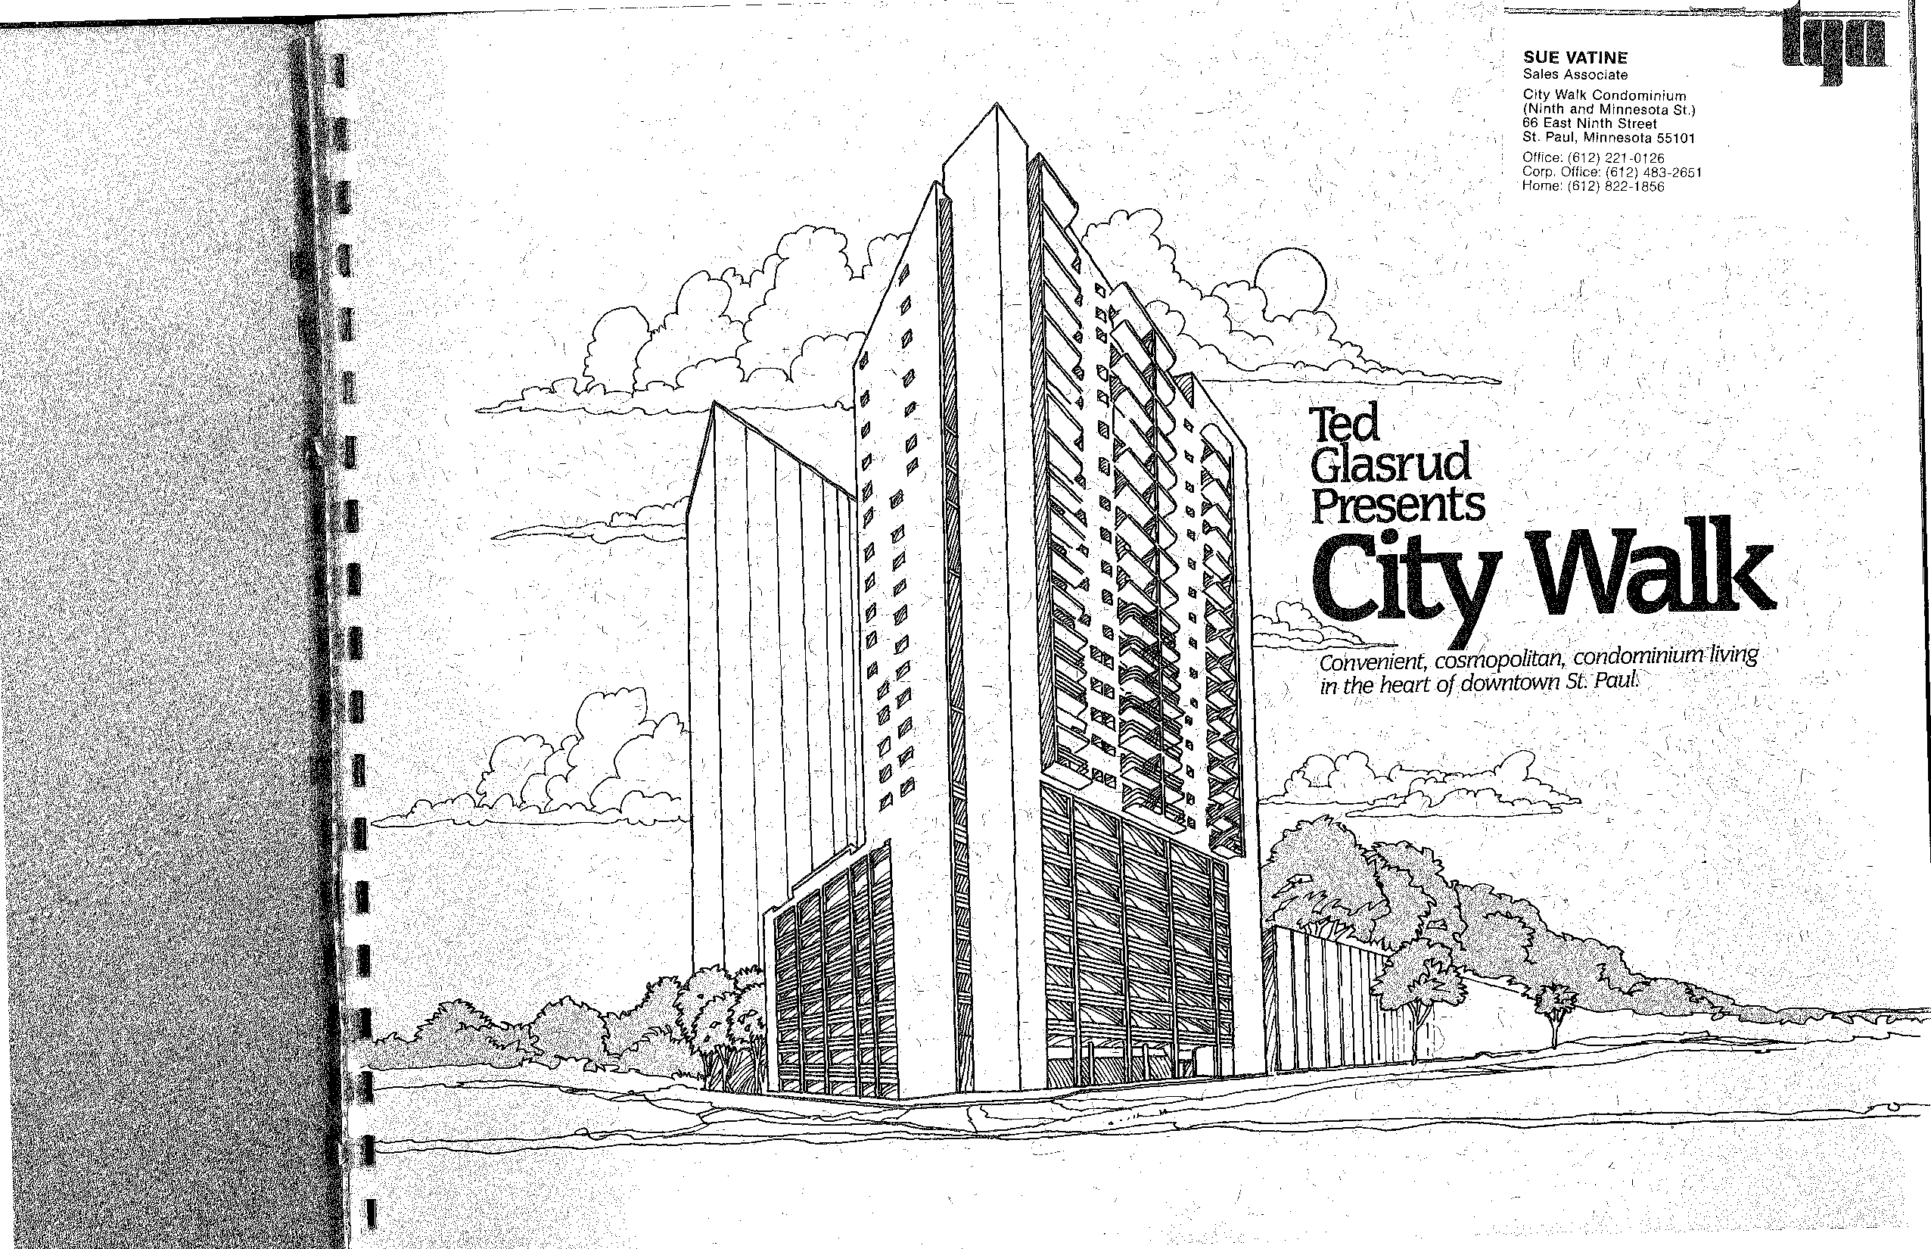
SUE VATINE
Sales Associate
City Walk Condominium
(Ninth and Minnesota St.) 66 East Ninth Street
St. Paul, Minnesota 55101
Office: (612) 221-0126 Corp. Office: (612) 483-2651 Home: (612) 822-1856
Convenient, cosmopolitan, condominium living in-the heart, of ,downtown St PauL'

Slide 2
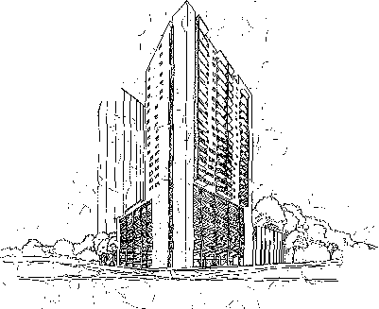
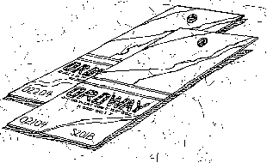
k.
•
•
City Walk...a cosmopQlitan lifestyle richly your own.
Downtown St. Paul. Rich in the tradi-
cine, law, business, the .arts, communications and more. 'Here in the heart of down-
' culture. Froth the World • 11⁻ade Center to Town Square, from chamber - music at the Ordway to jazz
Lowertown, from
tion of the great⁻⁻
empire build-' ers. James J. Hill
town St. Paul is City Walk.
A luxurious new condo-
toric museums
made his for-
.; minium community
tune here..
Where the rich tra-
to folk art and
Henry Sibley,
ditions
that are,
Alexander
St. Paulblend
Ramsey, the McKnights...all built their lives and their dreams here.
with .the up-
street music, St. Paul has an alluring chant that goes far pleeperthan tinsel, glitter and neon lights.
`City Walk. Downtown
St. Pauf. Come. Live the carefree, "cosmopolitan life-style of your dreams. It's all here. Waiting for you2At City Walk.
scale, upbeat, uptown
Downtown St./Paul. A
lifestyles
that
are today.,
bustling river' town. &lilt on a strong foundation of com-
There is something magical about
merce and industry Sup- , sported by renowned leaders in science, technology, medi-
living at City Walk. In the heart of Minne-sota's Grande Dame city. Seat of state government. Centhr of a rich and varied

Slide 3
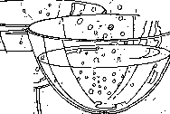
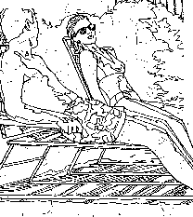
I
CityWalk. .a lifer
⁻11
love becoming
acuston7e
 | _{c}_C
city`Walk. s A convenient,
oP
Glasrbd standard, ,for civality shOws..,':eVery-whera Fromthe main entrance and common areas to the oak and bathroom fixtures
in each Conclothir#uni
-
rcioxn.'From the wide,-cpipt corridors to the _ bright, airy condo: 'minium units that welcome yOu home.,
And what about the
0
o O o ,
00 ®_{a}.
0..
(enjoy life'without the burdens of
coSmopolitan /
a home ancl⁻liard in the suburbs
d they, all
condominium lifestyle you'll quickly
nP Op
°
O
come to love.
people who live at City
Walk? They're people jUst
like you, Young
single and
00
have one thing in common. - A genuine
Carefully , designed to max-
, -
unit, Everything is
designed, constructed and , imize your
.maintained to assure you comfort -
of carefree, leisurely -- and con-,
venience -
Developed by Ted dasrud' •
love for the warm charm and rich ,traditions that make downtown St. haul such a unique community...corn, hined with' the vibrant growth and activity thai cause the city to literally _pulsate with excitement.
It a adds up to life stOe you'll love becoming accustomed to. City Walk: Downtown St. PauL It's
married
prOfes- _{v.}
sionals pur-
suing t_{i}neir careers in the
and respected as a lead- a quality
irnage and
ing builder/developer
qu4lity condominiums
environment.
_ —
7 ,
thriving St. Paul metrop-
from the TWin Cities to And people who live at
olis. CouplesVho have
Florida. Acclaimed for irino- City Walk do enjoy that raised their families and
vative design, quality cr quality From the outdoor, now want aNmore care
itianship outstanding uSe pool and sundeck to the⁻ free,⁻independent lifer e.
of space and attention i exercise room, sauna, and Retired-people vvho want_
to detail. / tastefully, furnished pa
e t _{pack up} 7 _{to} here. '_{a}W_{ke}al_{i}t_{t}in_{y}g_{oti}fo_{r}r_{h}y_{o}o_{m}u
th_{e.} freedom
and travel and generally ,c_{ity Walk}
A.
/

Slide 4
_.t
_ • .
•
City Walk...just a
skywalk away from
all of downtown a Paul.
i•
Ulawkoota Wong Vane Cantor
Donoistoons
The St. Paul Skyway system. Largest , public skyway system in the world.. More' than:two miles of connecting , skyway corridors link virtually all of downtown St. Paul into a magnificent indoor mall. It contains hundreds of shops, stores and services; parking rarrips; and a glass-enclosed indoor park that's larger. than a-football field.
Town liquor* (Otago Ill' ten.. COASIII0-•
COnwod Tower
HOOP
.Czantra; Woolworth'.
414
owe,
-•
)
vet\itl) Place Mall,
vvN ₄ ^{I}T^{'V}rt^{y}
Orem*
_ •
Twin Clty
Warm-apt* Mutuaf Lite
Center
_{.)})r •
Sixth Street
0.0111
Plaza
•
. Ilwr_West-kink
Atd9
On your way⁻to work, shopping or a' night on the town, 'yo, always have a choice., A leisurely stroll outdoors.
*work., tlonal
⁻Nth Street
-t among the"sights and sounds that are i so special to St. Paul. Or a comfortable
walk indoors, above the traffic, puddles,
- wind and weather that can challenge
Street
",_ I li; Minnesotans.
the endurance of the most hardy of .....
²'
2⁻⁻ - j ^{c6} ti The enchantment.of downtown St. Paul.
I_{A}.-_{Y.} l: L
2' - :- - • -
.,..,• The convenience of the skyway system,
----,— 7-- -
g ••• . .
-17 •
-:. _{k}, \'- : _. . -It's all part,of the comfortable, cosmO-⁻,
, ."---
.kr. • - t²rc/
- • . . -
.,•-• 7
,_,_._.•,, •-- 'politan lifeStyle that's waiting for you
CloloptIon
, - ,attity Walk.
•
I ,
• "\•
KelloggiPalk
•
•
(
.`
.
.)(. • It .
I •

Slide 5
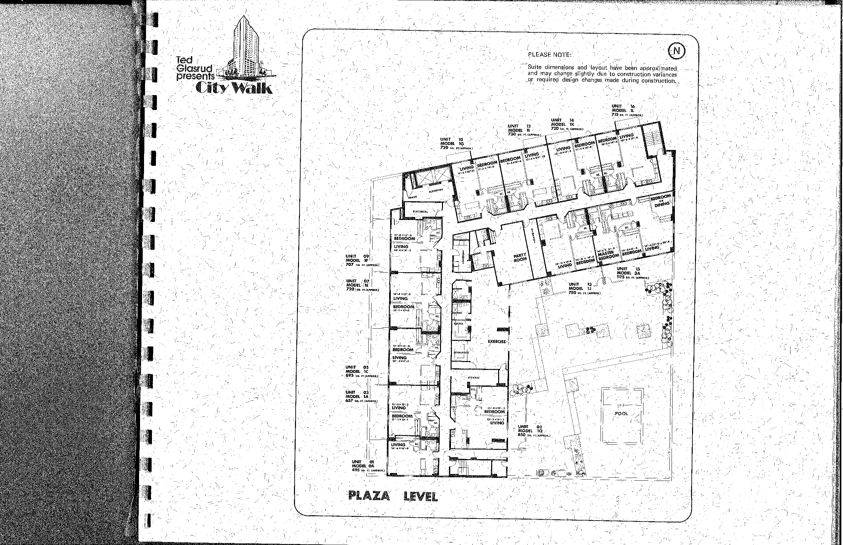
Ted
Glasrud⁻presents
Suite dimensions and 'layout have been approximated and may change slightly due to construction variances or required design changes Made during construction.
City Walk
UNIT 12 MODEL 11
730 FT. (APP.. )
UNIT 10 )?- -
MODEL 16.J
720 so. sr6.ioiss0 I
•
.;'
•
.r' ⁻...₄...:,
...) - • -... ,...?:,, , . :.). (. ', . ..'NA .. .
.. -^{s}- , • i.! s..\,. .. Z._ . - , :'
•
- - . • • • • : - I
. .
e- • .•.' . ." •—• -4
— I . I
UNIT .03 MODEL 1A
657 so. rr. (APPROXJ
rl
.c1
) • \
• '
⁻r •-'
_ • . . •
-

Slide 6
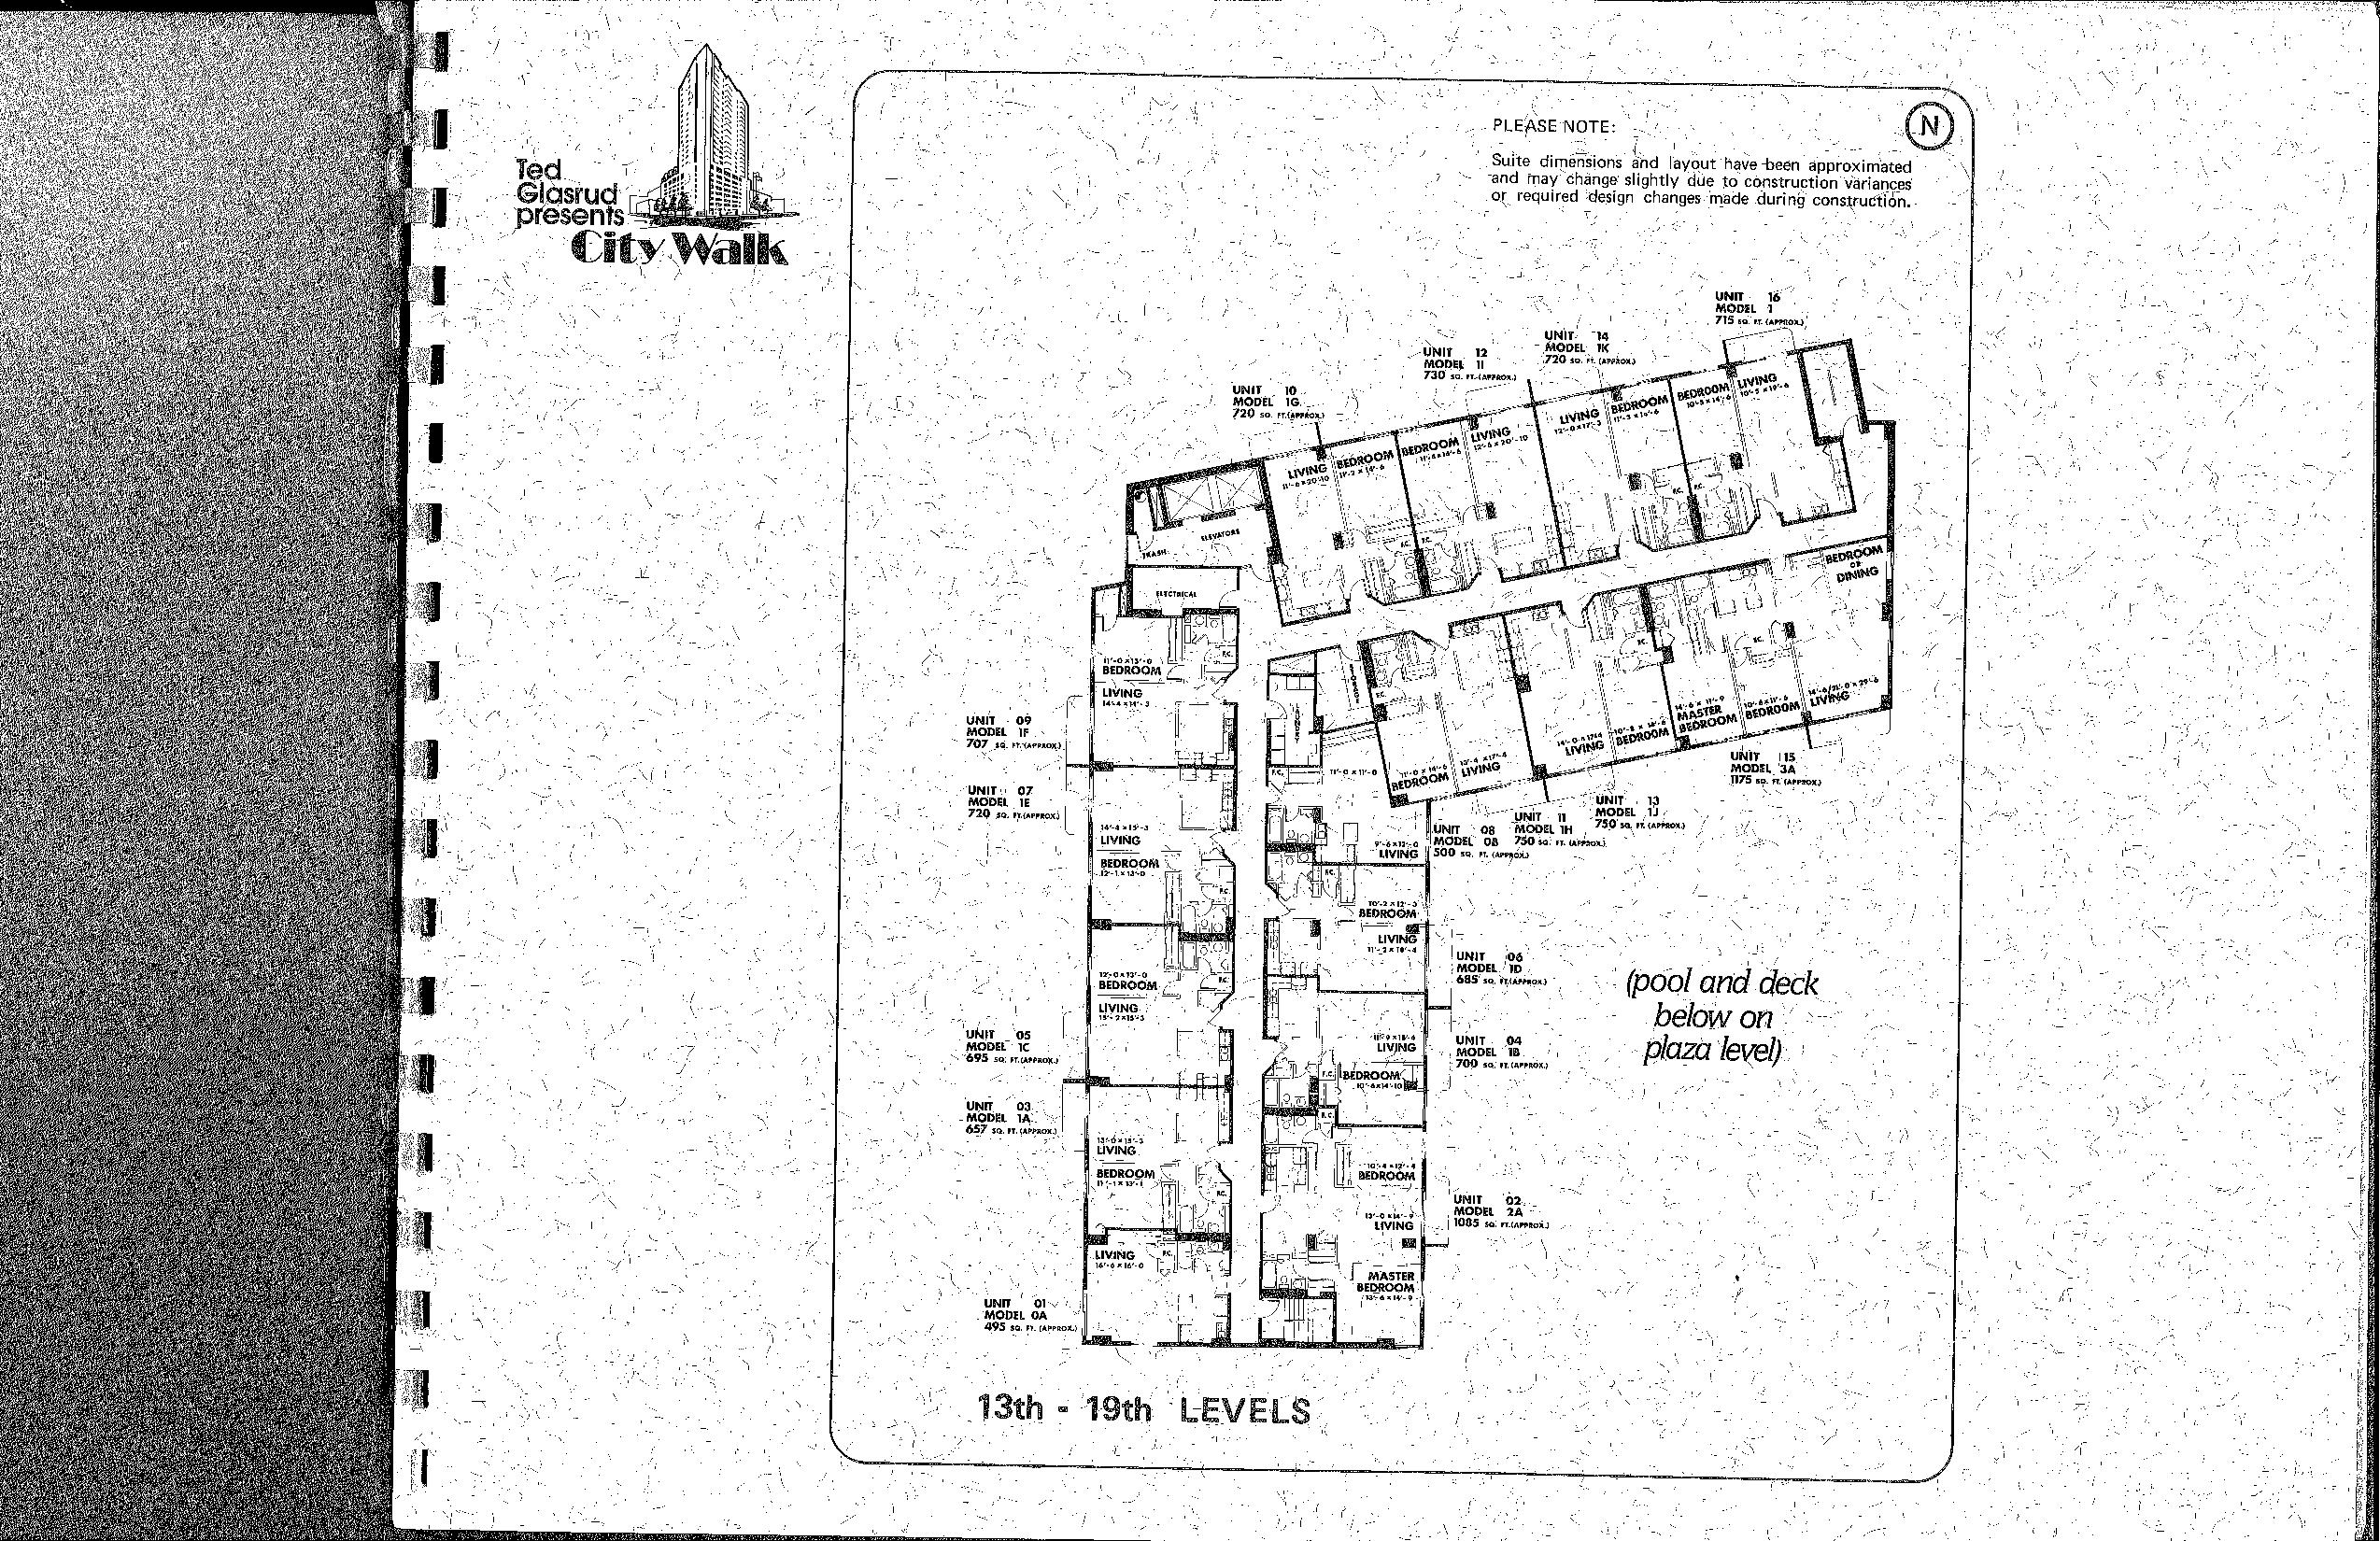
PLEASE NOTE:
Ted
Glasrud presents
Suite dimensions and layout have been approximated and may change slightly due to construction variances or required design changes made during construction.
City Walk
UNIT 16 MODEL 1
715 sett (oiroox4
UNIT ⁻14 r
•
UNIT 12
MODEL ii
730 SO. IT. (APPXOX I
MODEL 1K 720 so. rs.sorsooss4
UNIT 10 MODEL 1G 720 so. ITJAPPROXJ
' •.
•
-
rl
-\ • ;
'
-. •
UNIT 09
- '\ • - .1 •
; •
MODEL 1R . • 707 se. sv.sossecos
,••
UNIT ITS
v.O..^{1.4}"^{e}‘r.4¹⁴¹⁴.^{4.-}_{siD}eCRA
MODEL..3A ...075 so. ec (oriel")
- .
, • •• ) A -
UNIT 07 MODEL 1E
720 SO "(APP..)
UNIT 13
UNIT 11 MODEL 1J •
IMODEL. 08 750 so. Fr. (Amsox.)
I UNIT oa MODEL 1H 750 so rr (Amex.)
LIVING ! 500 so. IT (APIROX )
I UNIT ;06 MODEL JD
(pool and deck_
685 so. FTJAPPROX
below on plaza levek
I I
MODEL' 1C `•:4•95 co. er.ouoltoit.)
UNIT 04
•
•
\ • _MOIL,
\ 657 ga. "'CAM!"
. -s• , "
I MODEL 1B
700 60. Is (APPROX)
, • .
• \
' • • I - •
T0,644.10
12'•:$ BEDROOM
LIVING .
' MASTER
UNIT 02 MODEL 2A 1085 so. morrow.)
/-
UNIT 01
MODEL OA
495 so. yr. (APPROX)
_{I}UOIOOM
A
13th_ - lath LEVELS
_{t}__ 1, ,

Slide 7
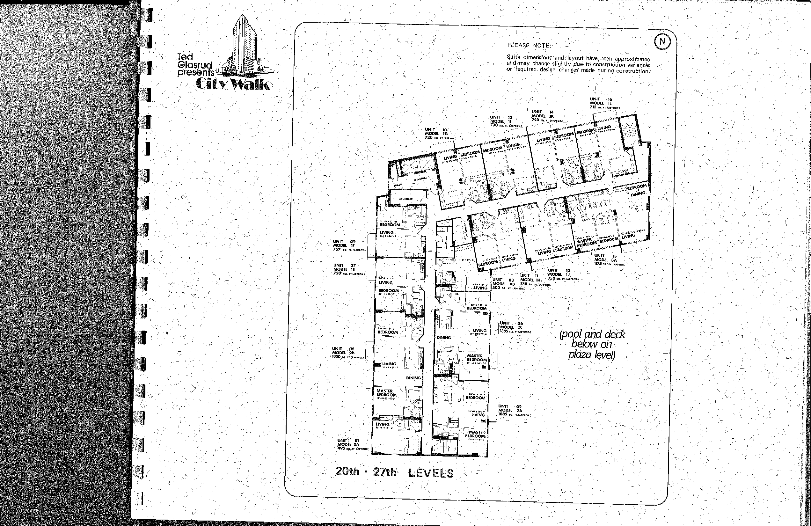
PLEASE NOTE:
Ted - Glasrud presents,
Suite dimensions and/layout have been approximated and,may change slightly due to construction variances .or ''required design changes made during construction.
City Wa
" • \
MODEL IL UN 1 •
⁰
_{N}il
( DNIT 14
715 .5 rt. truploo
..⁻G_{m}F_{o}li_{o}T_{EL .11_}12 5._{7,} • A°724::::_{!m}^{LlIC},_{Ami030}^{-.} '
730 scir.nomitia •
•
•
, • /7- '-
, - •/' - A .
_ • - ,
•
4
1, •
¹' • /
¹1
)r- • BEDILOQM_Z,.
UNIT 09 - I
MODEL IF LIVINGi es1 • ,
,,-
-5'.
707 so. FT. (APPROX) ^{I .I!}
• 15
•
UNIT 07
MODEL 1E
720 ea. IT.(APAFOX;
UNIT • 13
\\". moon 3A
•• r. n75 w: ft (APPROX
UNIT 11 MODEL 1J
UNIT , , 08 MODEL IN, 750 so. n(om...0x.)
(MODEL 08 750 so. PP. (APPROX.) 500 so. R. (APPROX.)
10,2.12,
BEDROOM
, LIVING
UNIT 06 MODEL 2C
1385 ruarreaL)
(pool and deck below on - plaza level)
UNIT 05 MODEL 28 1350 so. ITJAPPROX.)
1 'LIVING
23.-1x 18,2
_{-5'}
' '
MASTER BEDROOM
14^{.-}V.13:-10f
5,
• /
, • ,
IUNIT -02 MODEL 2A 1085 so. Ft(APPII0X.)
. . • )0 !--.¹
.1 •
MASTER
. LmETH
EL O
dl
495 ..i,.FT.U^{A} nseix.)
BEDROOM ,
x I
1 1 r• .
-••
,
20th - 27th LEVELS
1.; . •
¹4,- • ,
\
_
— • ,
'

Slide 8
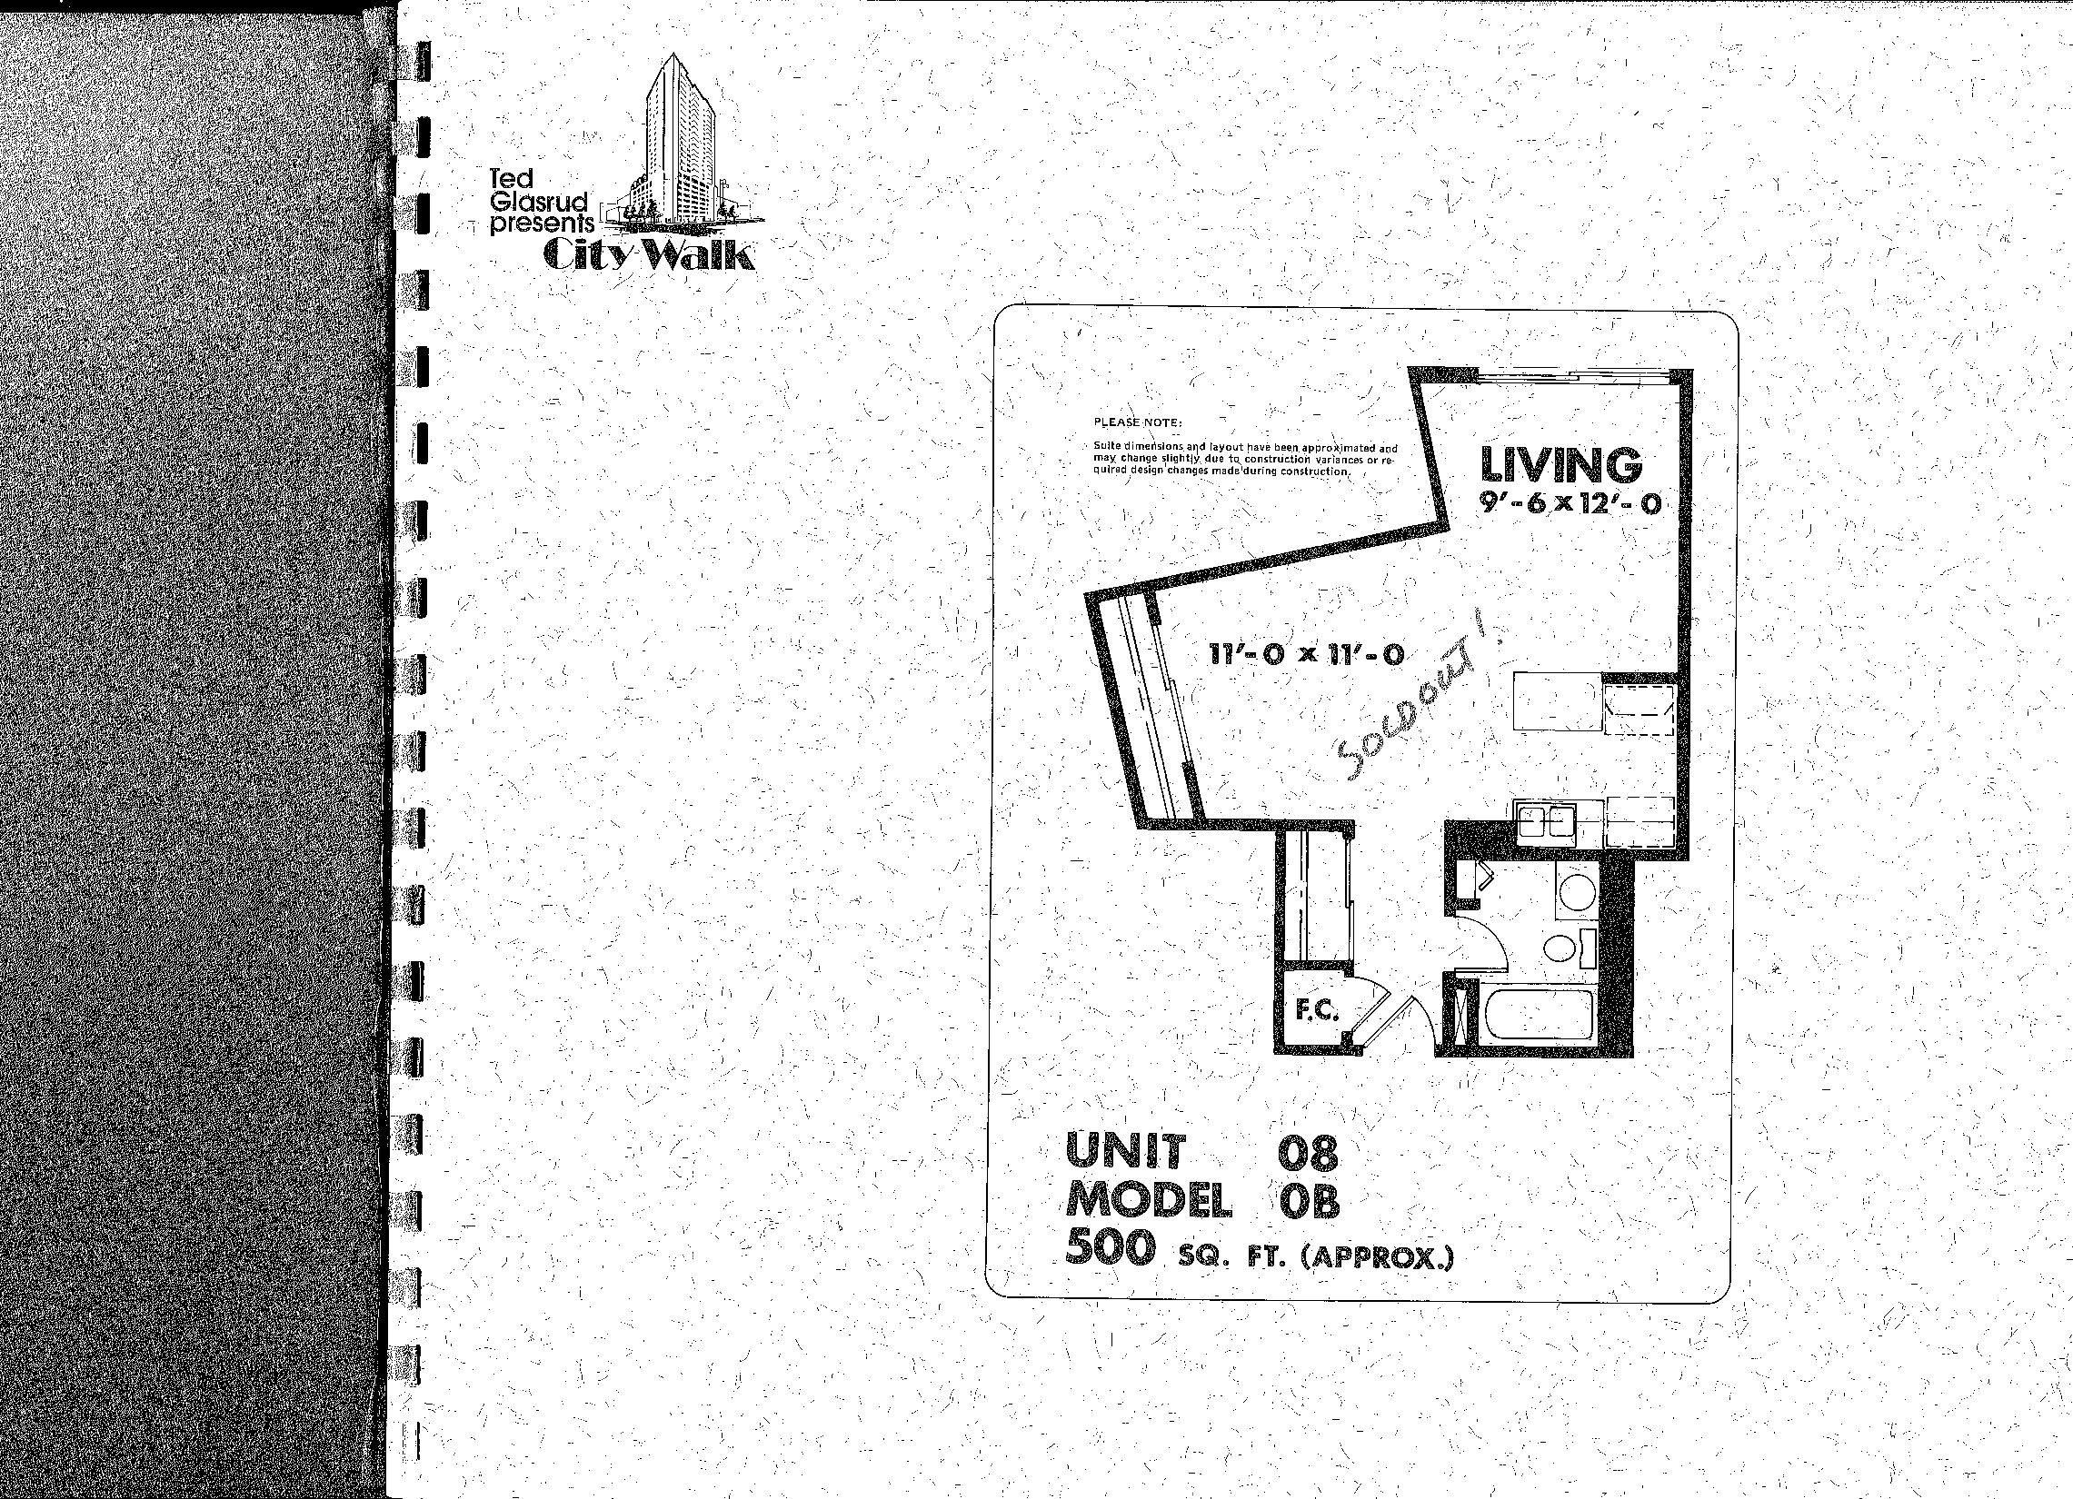
Ted
Glasrud presents
L
PlEA,01OTE: .
Suite dimensions, and layout have been.apprci -jmated and may change slight'y due to constitiction variances or re. _{s} - quire d design changes made during construction. r
1
•

Slide 9
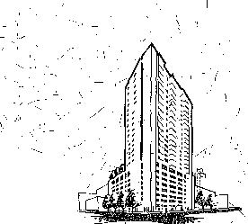
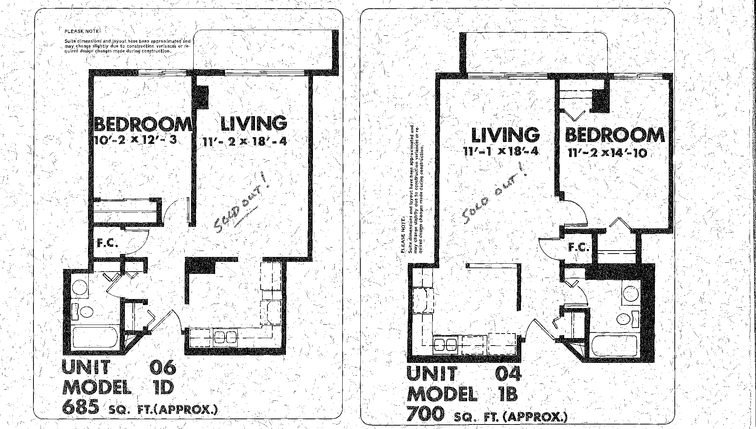
•
I; I; .
.e'•
•
'
- •
__{N. I/}
.7,
/ •
•
I
\
""" •
I ,
,.) • -
I'S •
Ted
Glasrud
presents
City Walk
PLEASE NO+
Suite dimensioni and „layout have been approximated and may change slightly due to construction variances or re-quired design changes made during construction.
\.
•
/

Slide 10
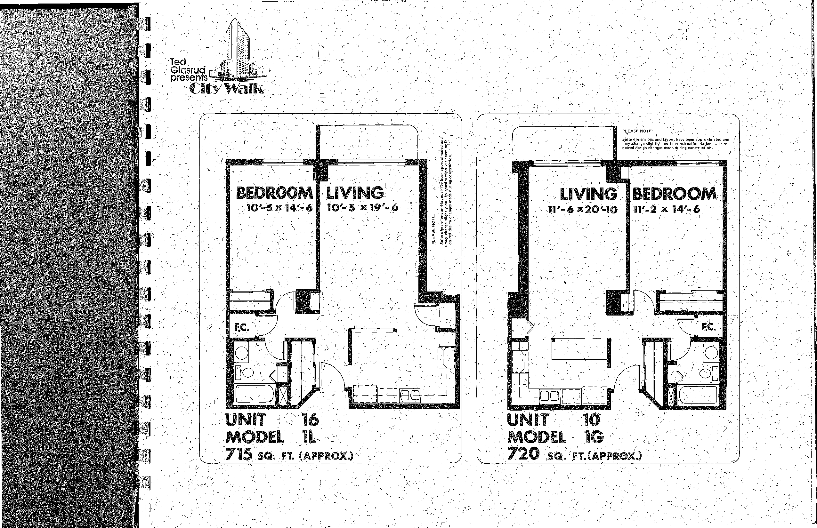
=Ted.
Glasrud presents
City Wd
PLEASE NOTE: . `„ '- I
, ..
Salta dimensiOs and,leyout have been approximated and
may change slightly, due to construction variances br re.
quired design changes made during construction.. .
_ \
i
7-
1- Is
L
N.
,•
•
'
I
•
)
1

Slide 11
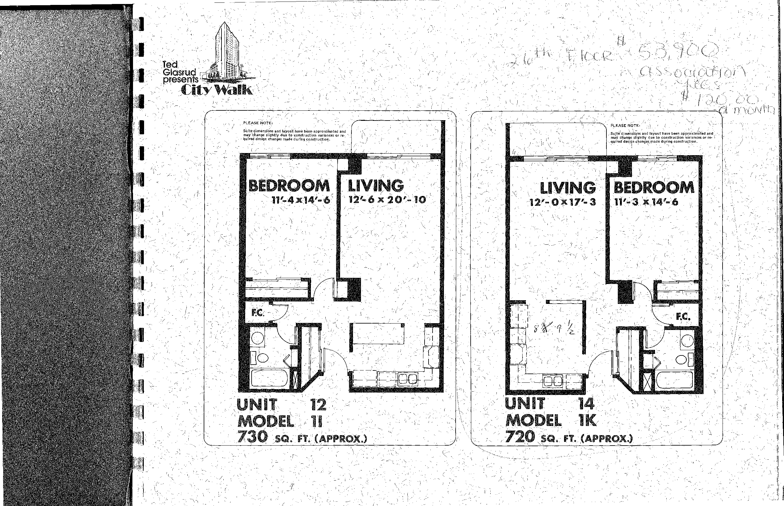
•
J '
Z. • -
Ted
)
Glasrud presents
City Wal
•
)
Siiite dimensions and layout have been approxiMated and may change slightly due to construction variances or re- ' quired design changes made during construction.
PLEASE NOTE: }
Suite dimensions and layout have been approximated and may change slightly due to construction variances or re- • quired design changes made during construction.
) /¹4
-.. •
. ;•-• 1,
..e
\'(1
Li_{p}• •
•
•z1.
N.
I
•
•
—'.•,
I • •'
" •
/ • 1 1 • . •
•
•
I_{t}

Slide 12
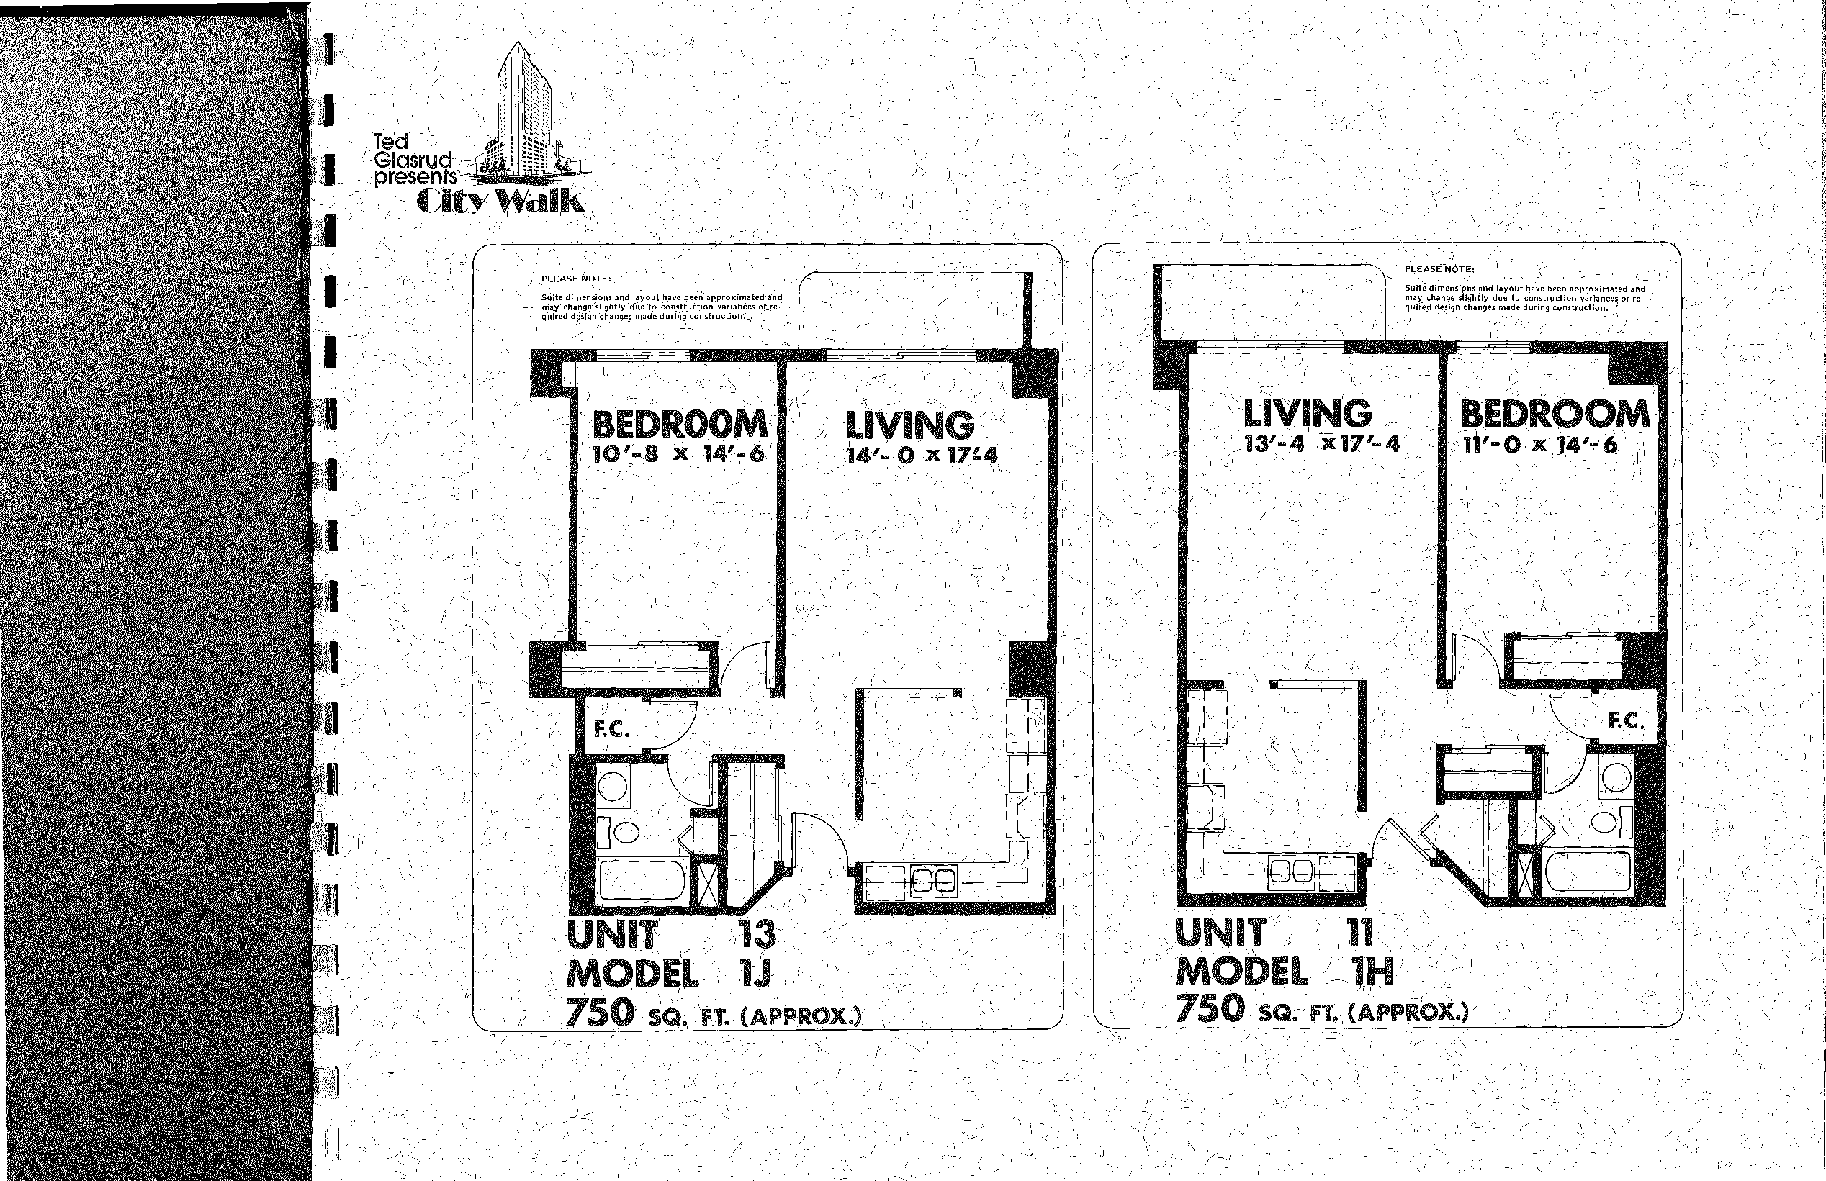
('
Ted Glasrud presents
„.-
' • l
City Walk
•
•
PLEASENOTEi
Suite dimensions and layout have been approximated and may change slightly due to construction variances or re-quired de!ign changes made during construction.
)
PLEASE MOTE:,/
Suite dimensions and layout have beaapproximated and may change elightly'due to construction varianaes or_re-quired detign changes made during construction.„..
BEDROOM
LIVING'
10¹-8 x 14¹-6 14¹- 0 x 17=4
-
F.C.
•
/
17
J
Fl
r
UNIT 13
MODAL
75O SD. FT. (APPROX.)

Slide 13
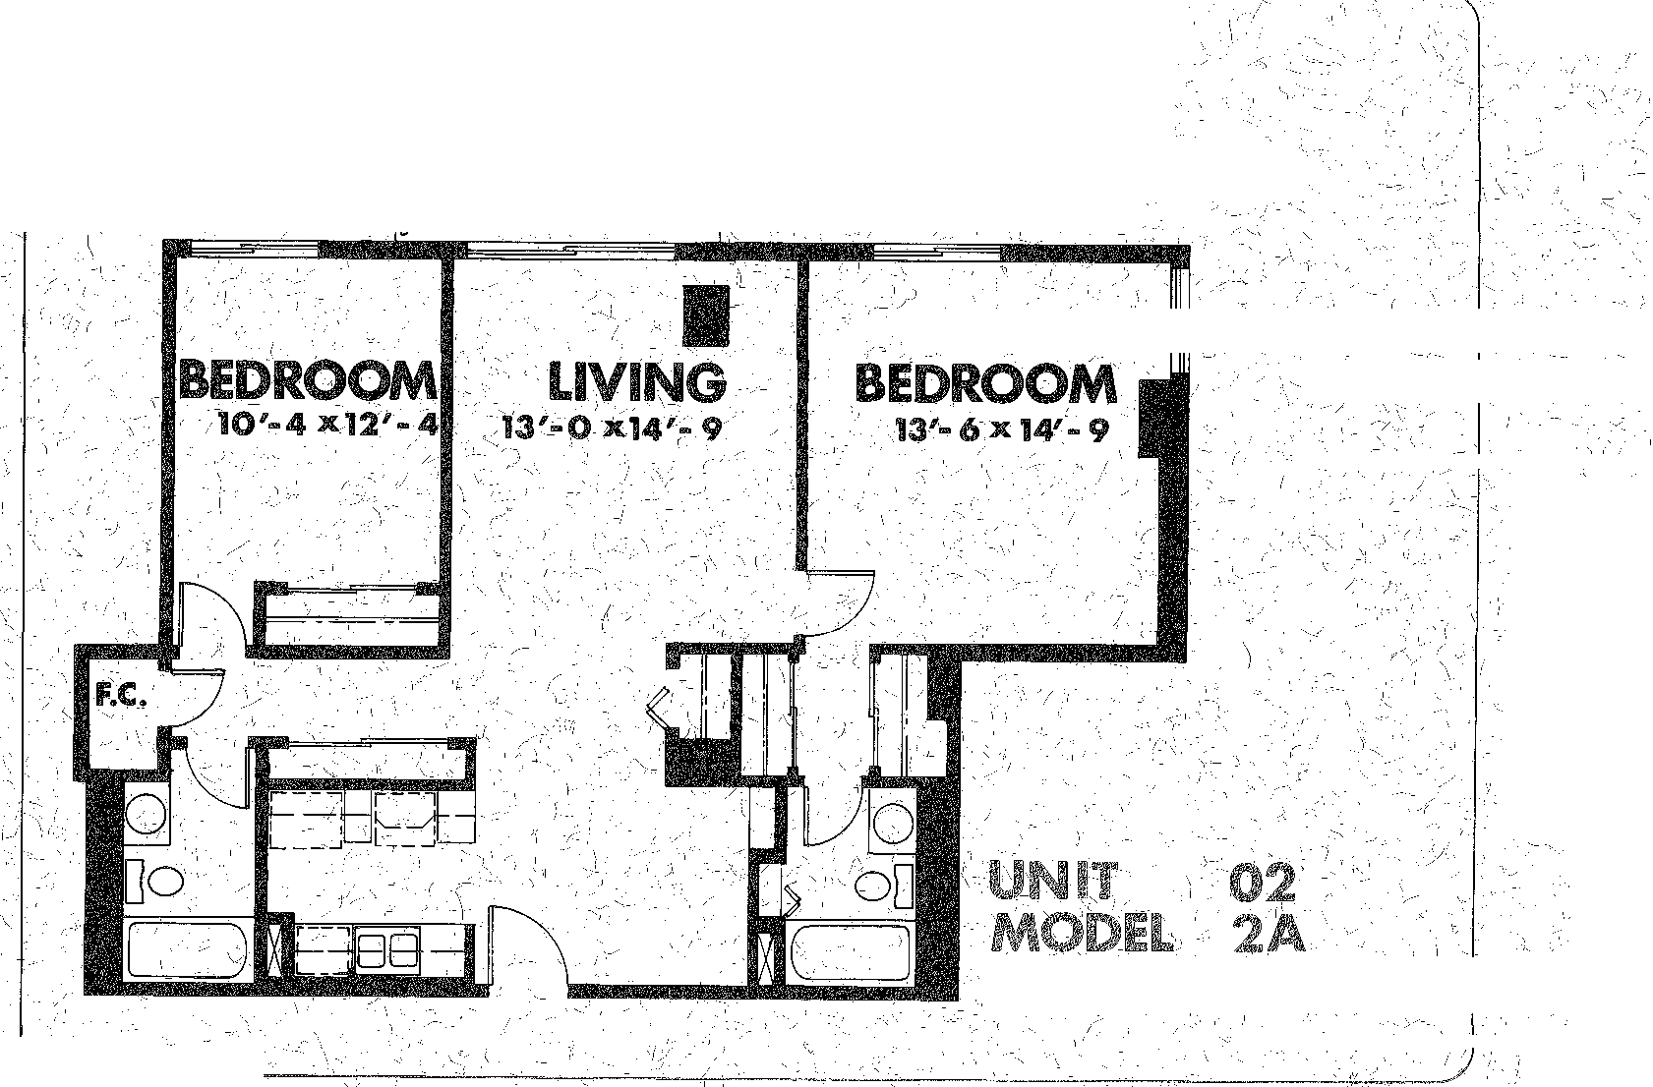
'"::.' ' ' - .• . • '
.•-• • .5 ----. 1
‘ Vi 4...„ II. ...
/1 i' • . • 7 \ / -² •- ' / ' ..¹ ' • .
-.._{i}r / ••••• .,.. / "
: • i • ,..-'''' III
.- 5.
-• t
i• N., -3.'• '• r -- • •_{I} - - -'/',...21(
-.
•
• • ,
. -•-•
•••... .
I • • . 5.- ' ' ...Y; ) --•••• ' •
I • - • „ .
₁
-4;
. • • .,• •••
,"•• t
• •⁻Y- • .) -•••
: "--: .•••f-
. . • )' `.... .,
^{'I}'D': ' '• • i • " 5-:" •-•.' • - -) -,
;• L.,./ .. ₁-,
.- • : -• •
-5., , ,,,_{i} . / ,,, _
I • - -
I• • .., • ....." - - .,,‘
, . : ,-'-••• •• • ^{i} ) . • .-...--)- ' • •-• - - t ⁻A,.
— • I ( . • ••
•
. - • •• .• .- • • 2 ....- - 7.-⁻⁻; • '. •• i (--⁻3.- -.. ) V ., .
2 . •-- -1 p •
Tea' ! -cc •
'I. "⁷/ . - • ( - .
-• .. ' _'- ..
.-. . .:- -i •,, . . _, __ , .
5-
-
. - . ( .);
Citypesets
al
(
.\
z
I
_ •
-• • • ' • _
. •
A ' ''
f"..k ''' • - _ •
.•• ,
) •
9. 7, • 4 i • •c ) '. • • —. ..
- , — I⁻
. •• • ^{:-.7}1.', •• ' ./ • '''' .-.. _, •,n.- '''t _{•N} ^{t'I}
,,-- ,
- - 'c'• -'•
- . •-• )--/,‘' • , I ^{s} ' .: I: •
-1 ',-..4'⁻ • ¹ ' ' -- • ,
f )-- -
'''^{.3} ' \⁻l— -' ----• . • • ,N.'.... ' ^{N}.- ' _ , .1 4 ' _. :'^{'1}/₄'4.⁽ '- k
4 ' . .1-- • - .%- , '.. .' ji:⁻.⁻ r' . ),, . It - .
'N.., . : . ....." ) i ...._ . • . 1 , , .. .
- • --•••• " 2- • ......,--•: • _{f}• • . • '⁻f) -•I^{T}.-••⁻',:\ ; ',"' , - • ,
!re⁻! '- - 't , • -• - (' • 'rt.: , " . . - • - • • :-... ..„ r• . • ' -:,. _, : 1 . ,... \ ,_
_. i _{I.} ... ,._, _ , . - ••... _ .... \ \
, . - • . ..5c . .?-_{i}'•...„,:.
. ._ _ •
' --•
/
(-_.' . • ⁻1
¹4⁻•
•
.
.•.
.. • ' ' •
. , • . .• - _
r
F •
•
-•••.:' '. "Vv....¹ ' • . / •`-'\-- - I '''
jt • ) .. \ ,,_\ • ,
.-,-, ,- _ . 5. .- / g'Ulfe dimensions and layout have been approximated
-_,• - ,•••, '_{j} and mazy-Change slightly due to construction variances
t . .•.. ..: - :. or required design changes made during construction.
5'
— . A
,.e
~^{J} 4 t
_{N...} • r
\ . ,l , ,••••
?__:. ( •''i. .• -.,
',• \ 7
- • ^{'N'} LI •
I.
,⁻.2 ••
.. , -
I • -
. • '
MASTER
/
/••-.
. ;)1,
- ,")) „,..5
e
- ( •
_ • 'r -' •
/ .
is
'
r .
--k •-• — • 7 /
'? • 1 '.4⁾1
\ 4% •
7⁽ • .n-1' ••• r: "?'
),
. • .³' •—. - •
•
I
' •
"
1085 sq. FT.(APPROX
,
5...
_ .
• • •' " • •3': " •
c,e• • •
, .
-
. % • • ₉ ‘.,
•
I f
.•. „ .⁴,;• A;
i -,•••••••-'•-•
/ "- .. •
•
-.1
• I - •
_ ) „.,, . • • • •
N‹ ¹ • • • • .
" ••", . . • • •
)-••- t ⁻;r•• - 0.₇
•• •
z-•:. • " • \
•••••.. - • i••"
•
- • • .
. • . --,-•-.
•. ³⁻2
.. • ' • •
• ^{is}
, •
- ⁻••••S --•-• • _ '.1 ••
,• • • ./ •• •
I. • • - " \ .,
at. \ • •• -• --• I
_
) ^{l}'•• • • I_{l}i- _ • ¹⁻ ' •• • .- •' .:„ /• • J k>, •-": • • • •
.-
1 - • • • I' •••' r -••••• - 4 ( • _{r} •

Slide 14
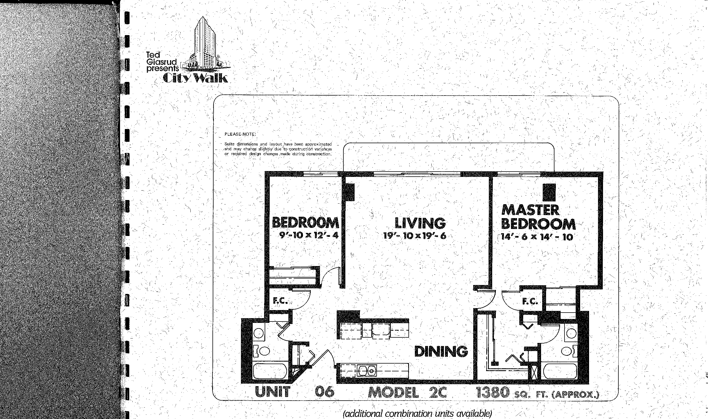
/
`•••••:-.
:'
_. •
. I.*
. •k)
•
— •
. -•
- .
Ted'
Glasrud.
presents'
<_{u}.
City Walk
-,••• , • -
/
- 1 _{I (}(
•
\ •
,PLEASE‘N,OT:
- Suite •dimenaions and layout have been approximated --, /and may change slightly due .to construction variances or re4ired design changes made during construction.
•
^{s•}S
• .;..•
‘.• } I •
- - - •• . __r
., • .
I 7,_{N} •
) • • • - • •
••••-4⁻• ₁ .4
- -
(additional combination units available) -

Slide 15
City Walk...a collection of exceptional features
Metal clad windows with %" insulated glass
All wood patio doors with 1" insulated glass
Metal clad weather-stripped insulated entry-doors for safety
arid, soundproofing ,
All oak woodwork and trim plus solid core passage doors and trim
All oak/kitchen cabinets and vanities
Hotpoint range With self-cleaning oven
Hotpoint range hood fan
HotpOint,,dishwasher
',Hotpoint diSposal ,
¹ Single lever faucets on all sinks andbaths
Fiberglass bath bays with ,white ceramic bath floors
Luxurious carpeting throughout
"No Wak" vinyl kitchen floors
Postformed Formica bathroom' vanity, and kitchen countertops
Complete light fixture packages
Sprayed textured ceilings.,
'All interior walls paintedwith latex paint by "Sherwin _{:k}
Williams"—,-color: Antique White '
Decorating service provided by Ted Glasrud Associates
Security system as convenient as your telephone.
Rooftop plaza with sundeck and swimming pool
Furnished lounge
Well-equipped exercise room with sauna and whirlpool
Laundries on each floor
Every condominium unit and all common sareas are '`. indrsndually eqilipped with fire sprinklers and smoke detettors

